Slide 1


SAPUI5: Data Binding
Version 1.0, July 2015
Author Ross Hightower
Product SAPUI5
Level Beginner
November 16, 2017
Focus
Data binding in SAPUI5.
Public

Slide 2
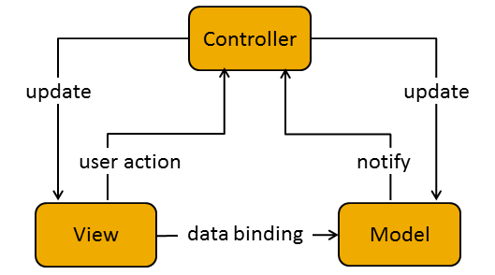
Model-View-Controller

Slide 3
Data Binding
Data in models are bound to controls in views and the model manages the binding.
There are three binding modes:
One-time binding – data is copied from the model to the view but if the model data changes, the view is not updated.
One-way binding – data from the model is displayed in the view but changes to the data in the view are not transferred to the model. If the data in the model changes the data in the view is updated.
Two-way binding – two way flow of data between the model and the view. Changes in one are reflected in the other. Two-way binding is the default binding method.

Slide 4
Data Binding
There are two types of bindings:
Single property – a single value from the model is bound to a property in a control. For example, the value property of an Input control is bound to a firstname property in the model <Input value=“{/firstname}” />
Aggregation – an aggregation binding allows multiple data items to be bound. For example, the items property of a List control can be bound to an array creating a list item for each item in the array. A template for the individual items must be provided. <List items=“{/employees}” />

Slide 5
Binding Context
When a control is bound to a data element, a binding context is created.
The binding context contains properties and methods to manage the data binding and an event which fires whenever the data in the model or view changes.
One of the properties of the binding context is the path to the data in the data model that is bound to the control

Slide 6
Binding Path
{
"HelloCollection": [
{
"Language" : "English",
"Greeting" : "Hello World!",
"Variations" : [
{
"Language" : "English",
"Greeting" : "Tootles!"
},
{
"Language" : "English",
"Greeting" : "Yo!"
}
]
},
{
"Language" : “Français",
"Greeting" : "Bonjour le monde!"
}
]
}
Array
JSON model used in case HD1C01. JSON uses JavaScript notation so arrays use square brackets [ ] and objects use curly brackets { }.
One property of the binding context is the binding path which indicates the specific property or object in the model data that is bound.
The binding path uses a typical RESTful URL syntax.
The root of the model is indicated by a / and the various levels of the model are separated by /s. Items in arrays are indicated by a zero based index.

Slide 7
Binding Path
{
"HelloCollection": [
{
"Language" : "English",
"Greeting" : "Hello World!",
"Variations" : [
{
"Language" : "English",
"Greeting" : "Tootles!"
},
{
"Language" : "English",
"Greeting" : "Yo!"
}
]
},
{
"Language" : “Français",
"Greeting" : "Bonjour le monde!"
}
]
}
JS: HelloCollection
UI5: /HelloCollection
JS: HelloCollection[0].Language
UI5: /HelloCollection/0/Language
JS: HelloCollection[0]
UI5: /HelloCollection/0
JS: HelloCollection[0].Variations[1]
UI5: /HelloCollection/0/Variations/1
JS: HelloCollection[1]
UI5: /HelloCollection/1

Slide 8
Model Definition
Models can be based on JSON, XML or oData sources. The data source determines the syntax of the model definition but does not affect the syntax of data binding.
"models": {
"hello": {
"type": "sap.ui.model.json.JSONModel",
"uri": "model/HelloModel.json"
}
Could be a URI for a web service
Model name is used to reference the model.
Models are defined in the manifest.json file and are visible everywhere in the application

Slide 9
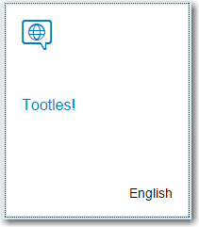
Property Binding
<StandardTile id="tileId" press="doIt" icon="sap-icon://hello-world"
title="{hello>/HelloCollection/0/Variations/0/Greetings}"
info="{hello>/HelloCollection/0/Variations/0/Language}" />

Slide 10
Aggregation Binding
Aggregation binding to array in data source. SAPUI5
will create a tile for each item in the array using the StandardTile control as the template for the tiles.
Model name
<TileContainer id="caseTiles" height="50%" tiles="{hello>/HelloCollection}">
<StandardTile id="tileId" press="doIt" icon="sap-icon://hello-world"
title="{hello>Greeting}"
info="{hello>Language}" />
</TileContainer>
Property bindings to individual elements. Note the lack of a leading /. This means the binding is relative binding and, in this case, it is relative to the specific item in the aggregation binding for which the tile is being created.

Slide 11
Formatter Functions
If you want to modify the data from model before it is displayed you can use a formatter function.
For example, if you want to convert a temperature from Kelvin to Celsius or you if the data element is a image filename and you want to construct a URL.
If a formatter function is specified, the data value is passed to the function and the return value is displayed in the control

Slide 12
Thank you
Contact information:
Ross Hightower
hightowe@uwm.edu

